Slide 1
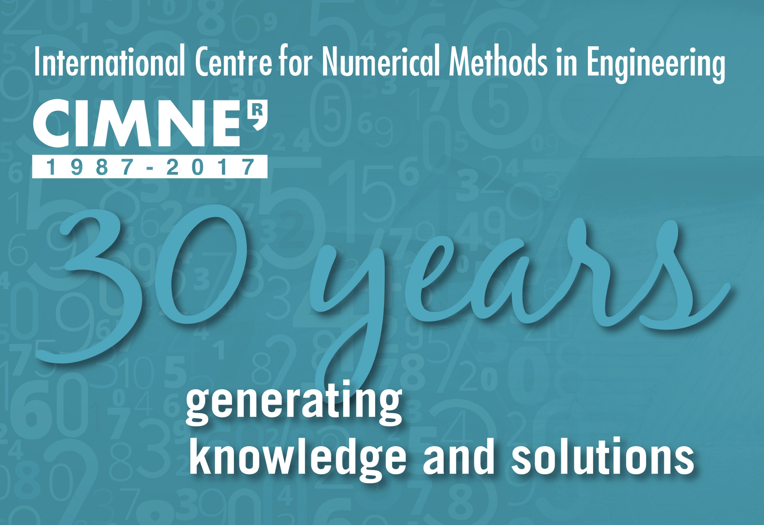

Slide 2

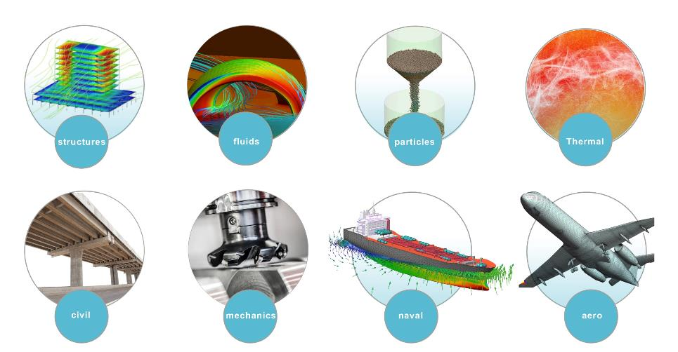
OUR MISSION…..
Research
Education
Dissemination
Technology Transfer
IN THE FIELD OF COMPUTATIONAL ENGINEERING

Slide 3
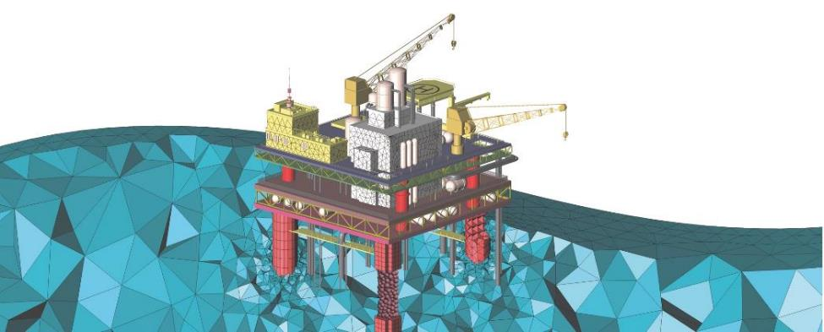
R+D center in computational mechanics created in 1987, with a strong focus on research, knowledge transfer, dissemination and application of numerical methods in engineering.
KNOW MORE ABOUT
CIMNE’s MISSION

Slide 4
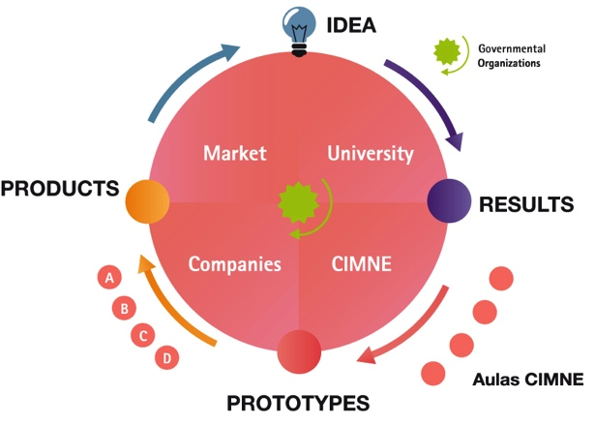
FROM THE Idea to the market
THE CYCLE OF IDEAS

Slide 5
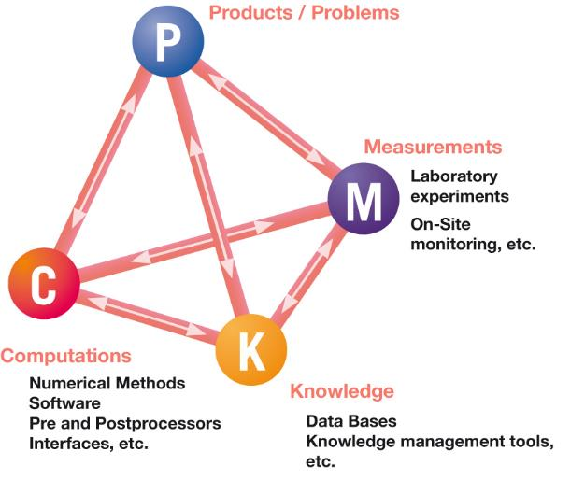
HOLISTIC VIEW OF RTD ACTIVITIES

Slide 6
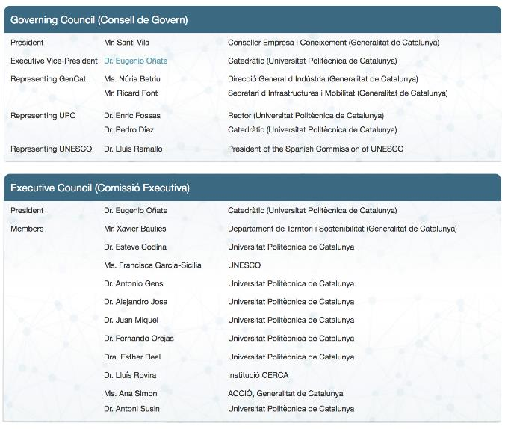
GOVERNING BODIES

Slide 7
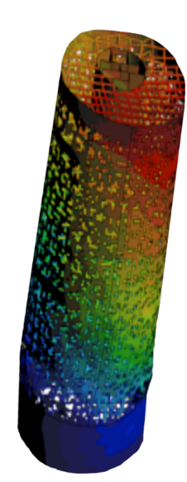
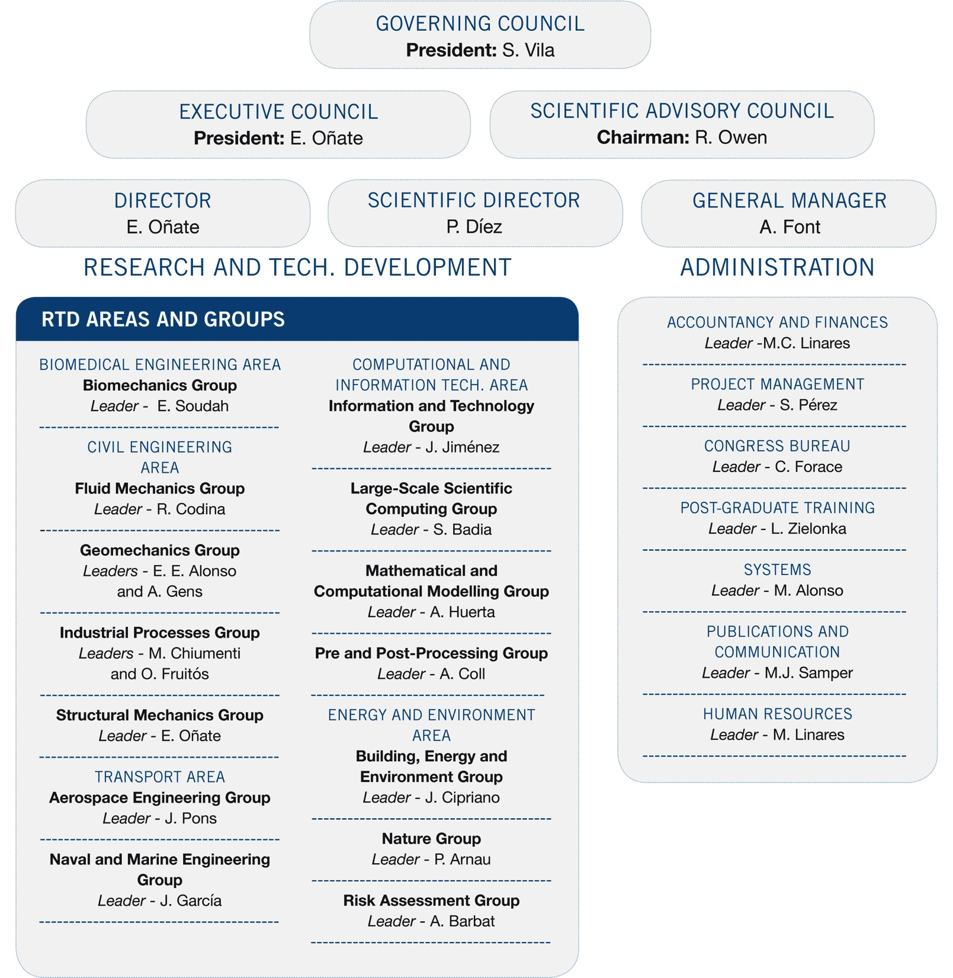
ORGANIZATION CHART

Slide 8
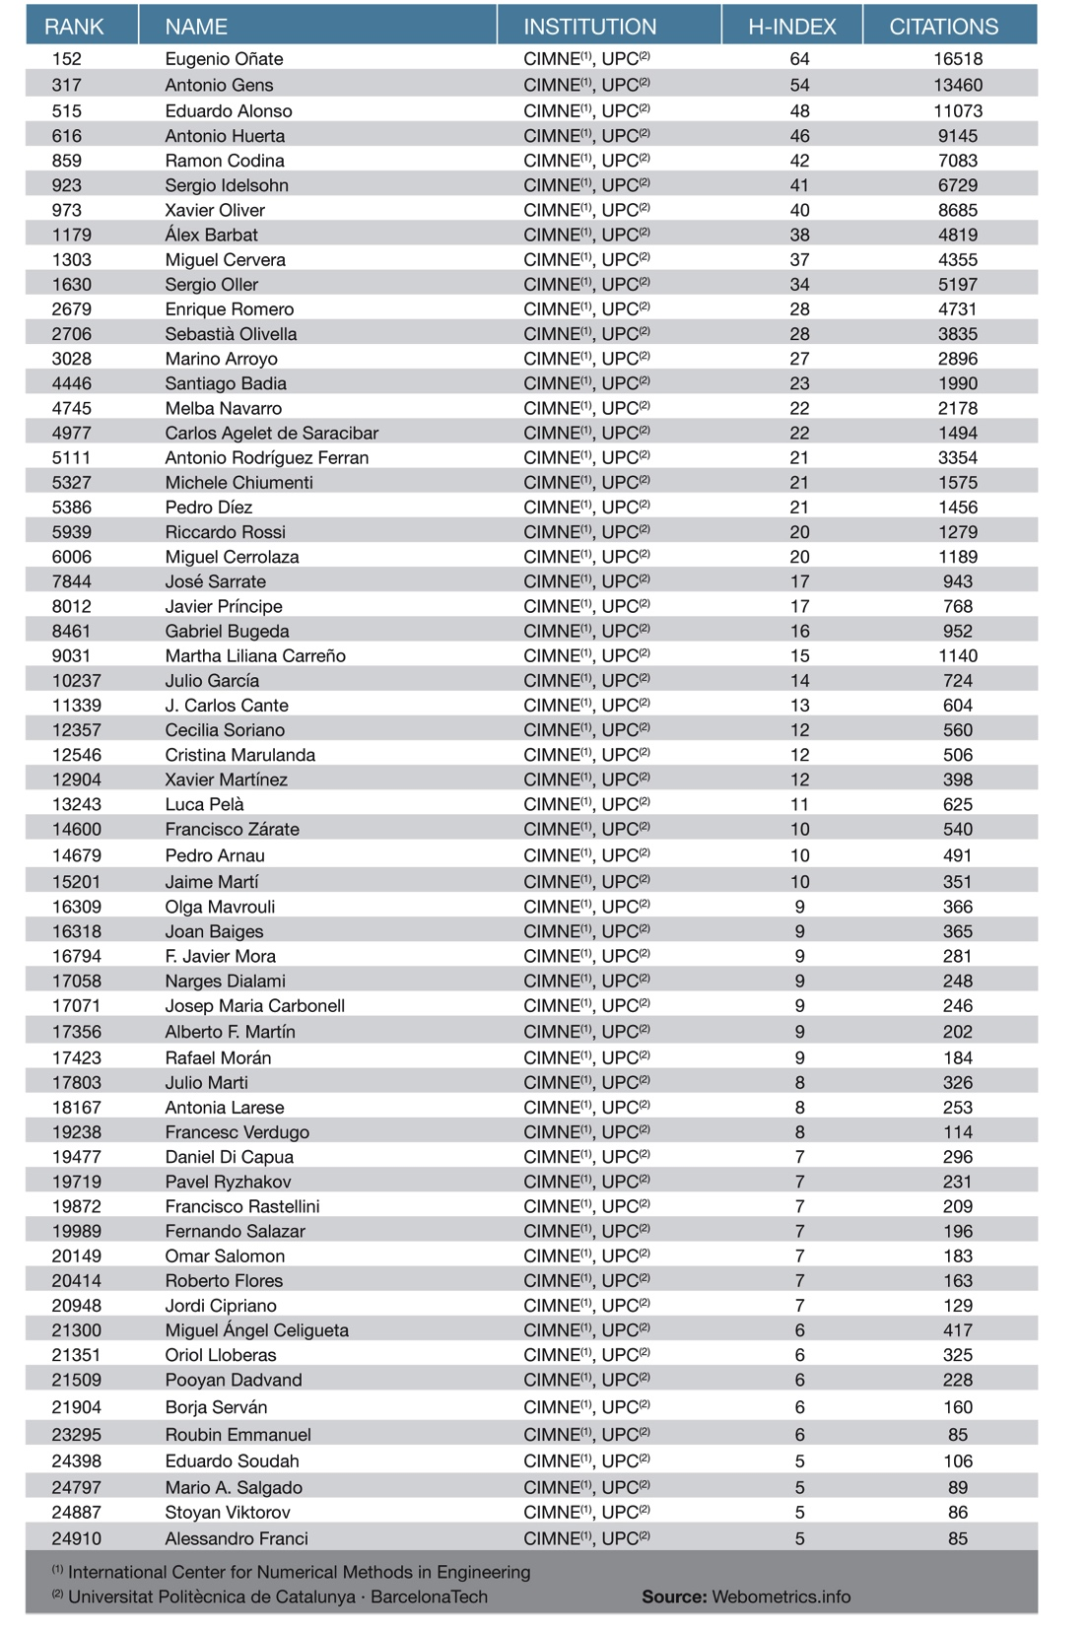
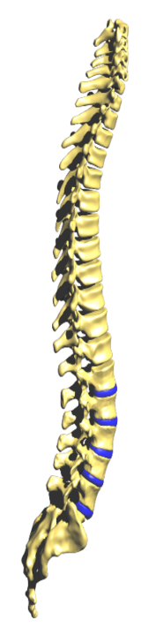
RANKINGS
60 researchers of CIMNE among the
25.000 highest cited
scientists in Spain

Slide 9
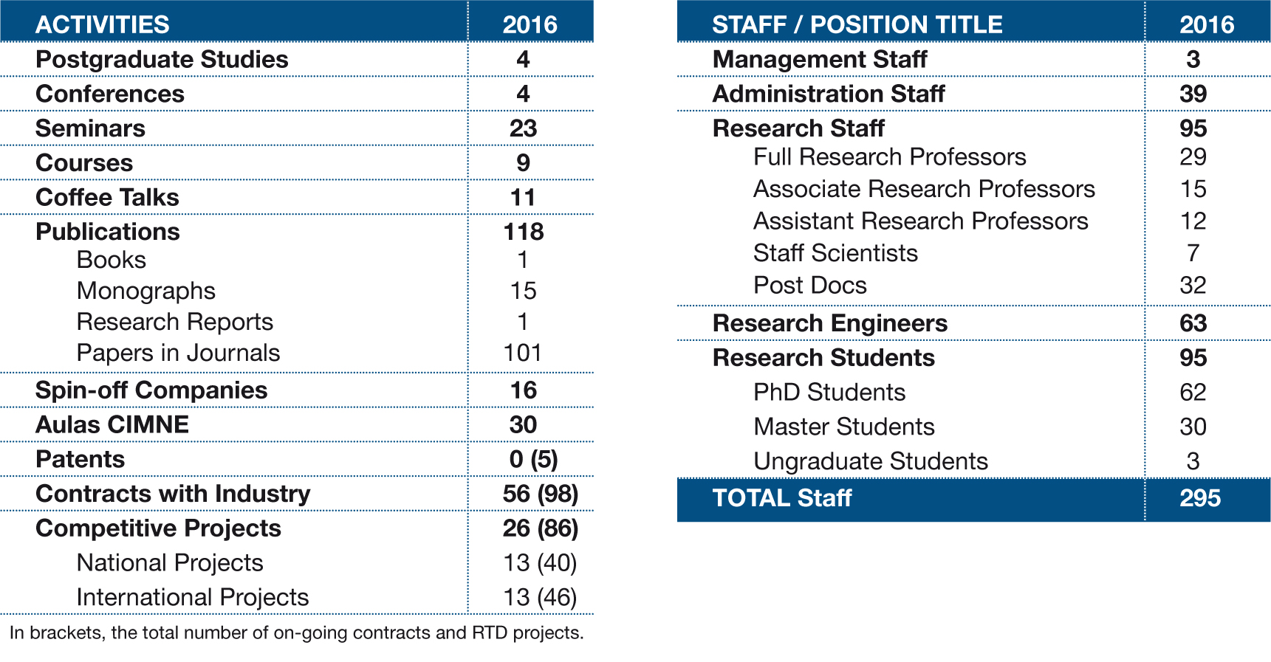
CIMNE IN NUMBERS
About 200 scientists work at CIMNE.

Slide 10
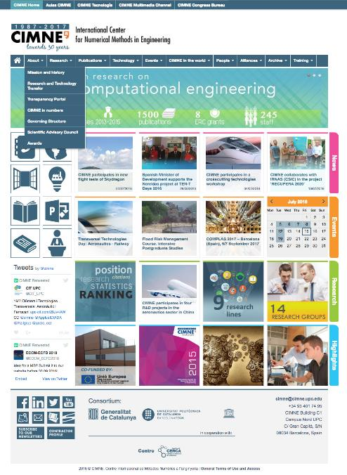
CIMNE
WEBSITE
Dropdown menu divided in ten sections to compile all the information about the center and its research activity worldwide.
Tool
Bar /Quick links
Modules divided by content: News (last information about the center’s activity), Events (programme of congresses and scientific meeting organized by CIMNE or those where it participates), Research (facts, figures, projects and research structure of CIMNE), Highlights (other important informations about the center).
Activity feed of Twitter
Footer with the social networks, contractor profile, logos of the consortium, contact information and copyright.

Slide 11
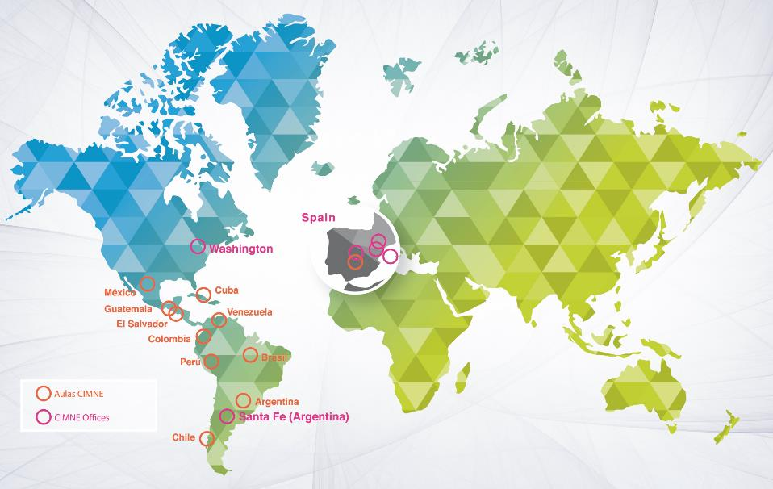
CIMNE IN THE WORLD

Slide 12
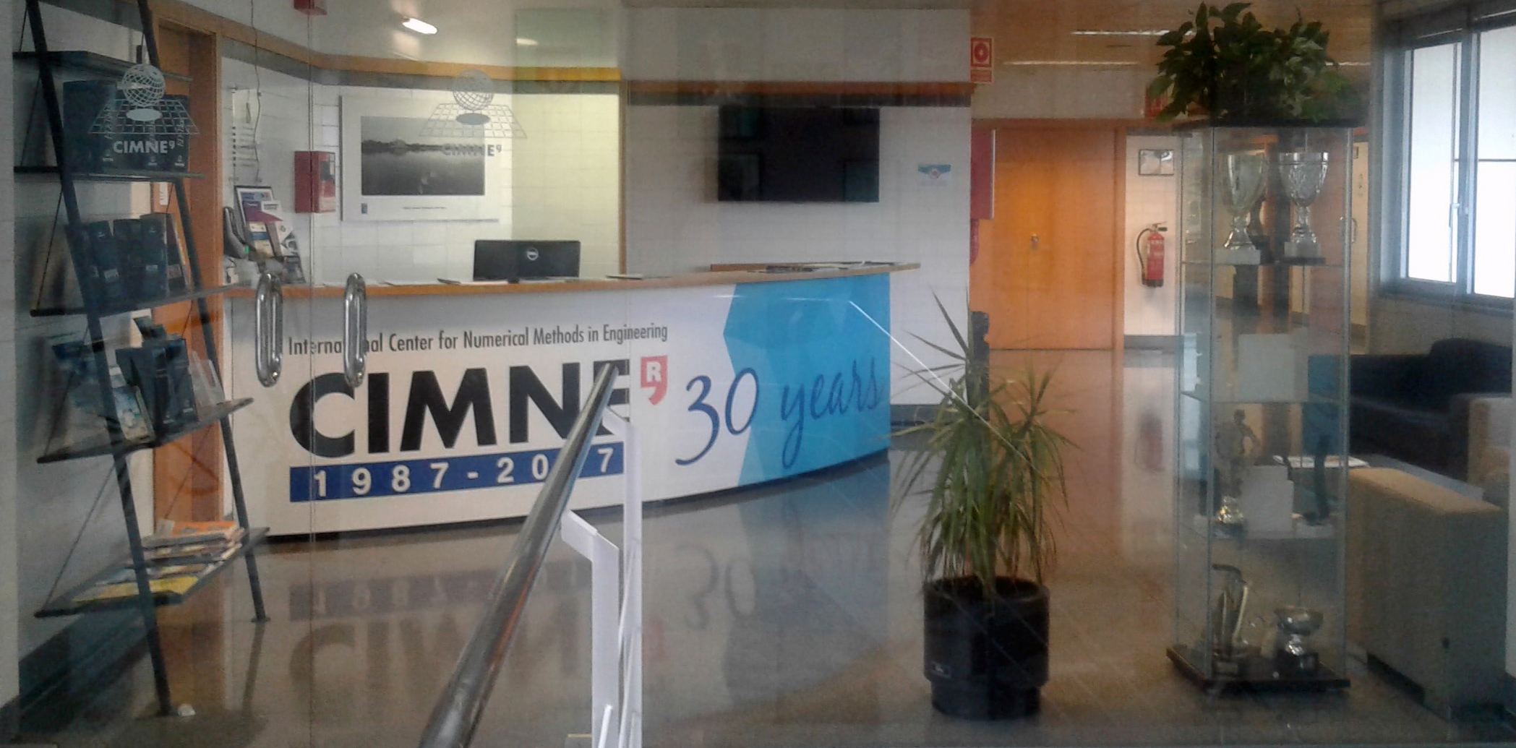
MAIN PREMISES
C1 BUILDING AT UPC NORTH CAMPUS

Slide 13
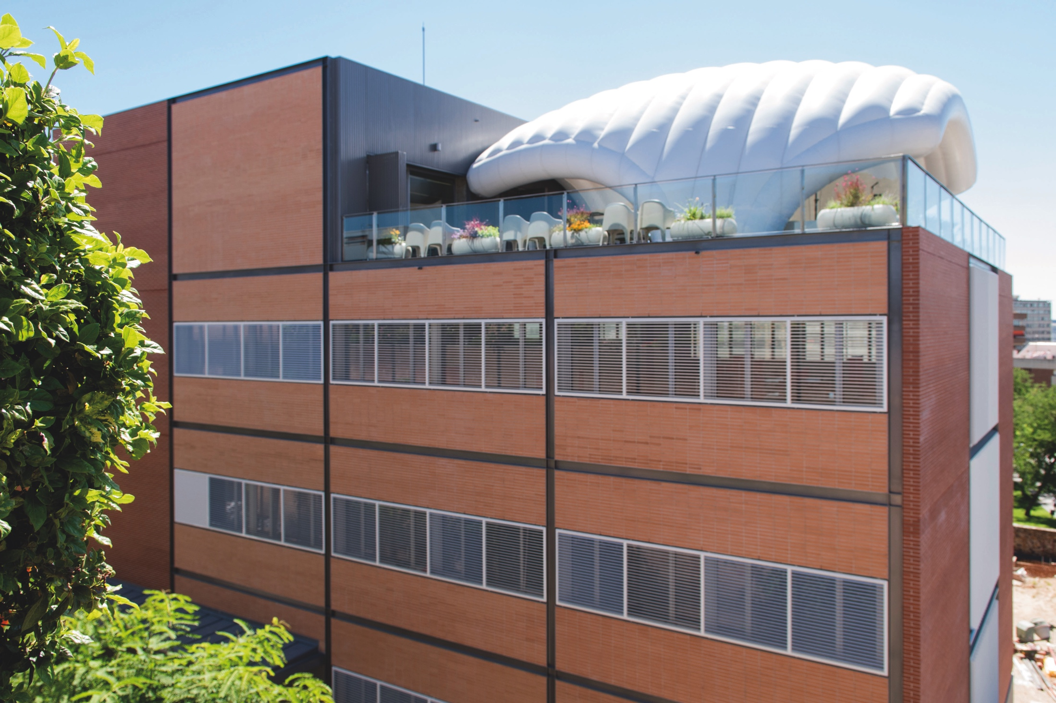
B0 BUILDING AT UPC NORTH CAMPUS SINCE 2016

Slide 14
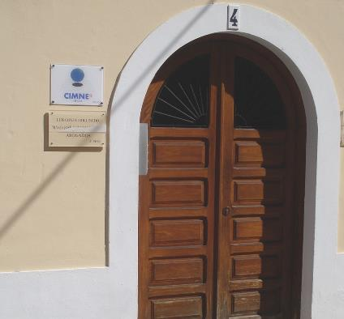
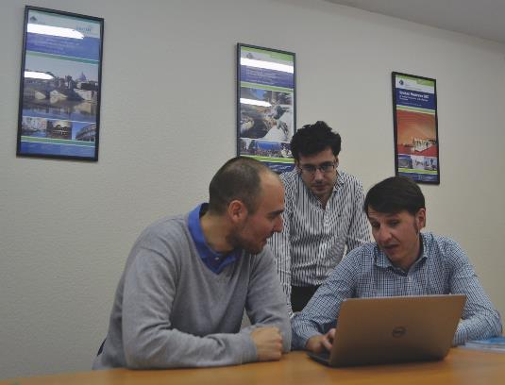
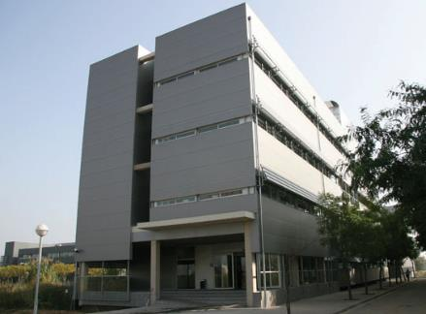
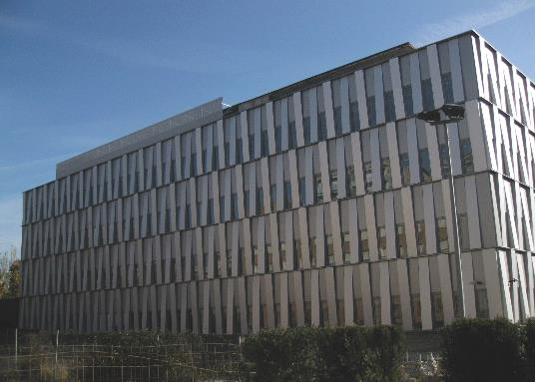
MADRID
IBIZA
PREMISES
IN SPAIN
TERRASSA (BCN)
CASTELLDEFELS (BCN)

Slide 15
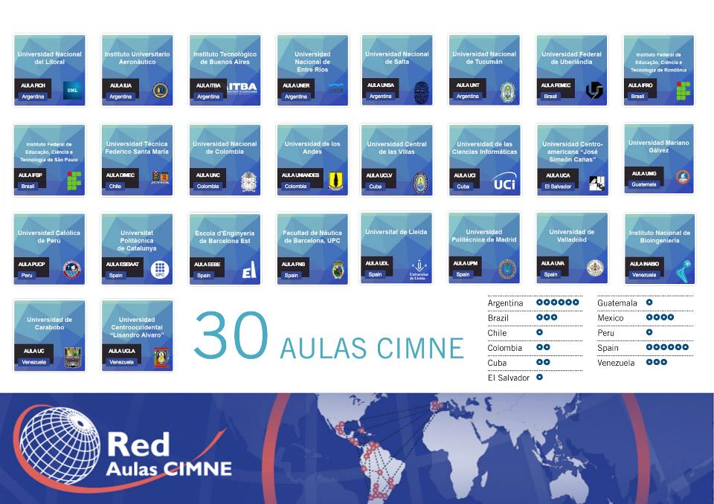

Slide 16
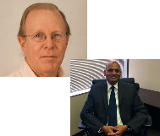
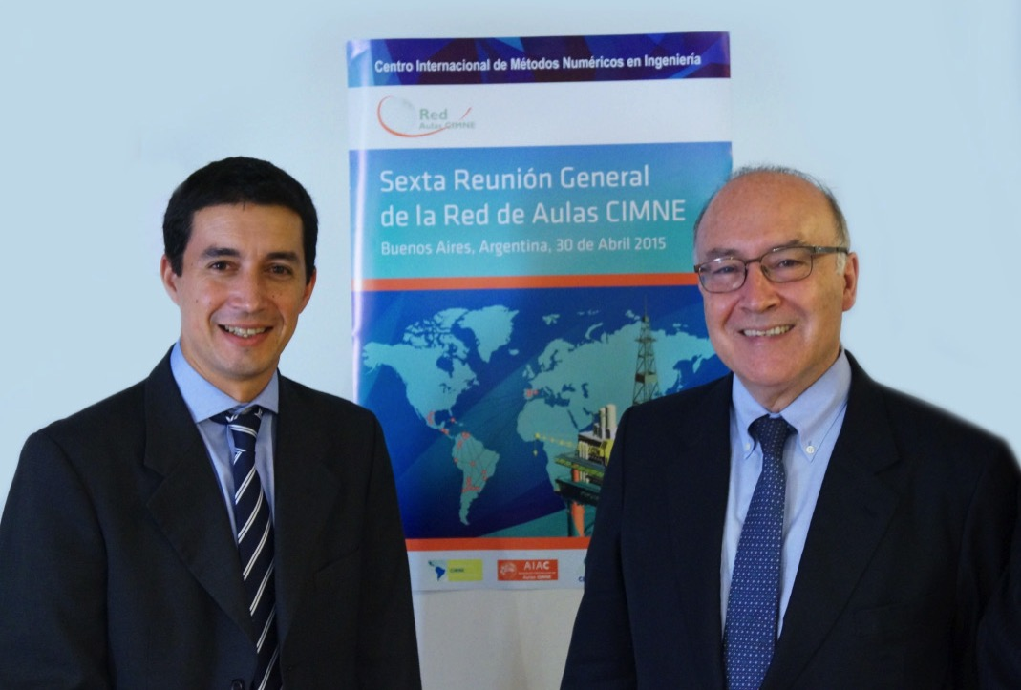
International branches
USA
CIMNE has promoted the creation of a non-profit corporation CIMNE-USA with the aim of fostering the scientific and technological activities of CIMNE in the US in cooperation with universities, research centers and enterprises in that country.
Dr. David Cranmer, CIMNE US Acting Executive Director, is a senior scientist at the National Institute of Standards and Technology (NIST) and advisor of many US companies. Mr. Varadaraju (Raju) Gandikota has recently been appointed CIMNE US Scientific Director.
Coordinator: Ms. Francisca García-Sicilia.
^{www.cimne.com/usa}
LATIN AMERICA
The formal establishment of CIMNE in Latin America has been initiated by creating a Foundation to foster the activity of CIMNE in that region.
CIMNE-Latin American Foundation (FCL) is located in the city of Santa Fe (Argentina), the place where the first CIMNE Classroom in the Latin America was created in cooperation with the University of Litoral.
Coordinator: Mr. Javier Piazzese.
^{www.cimne.com/fcl}

Slide 17
ACTIVITIES IN ASIA PACIFIC
CHINA
SINGAPORE
For more than 10 years, CIMNE has been collaborating with the People’s Republic of China in a number of fruitful cooperation agreements, RTD projects and some educational activities.
CIMNE has strong links with the most renowned scientific institutions in China, such as Peking University, Tsinghua University and several research centres of the Chinese Academy of Sciences or the Chinese Aeronautics Establishment.
Supported by the 6th and 7th Framework Programme and the Horizon 2020 of the European Union, CIMNE has carried out the coordination on the European side of a series of projects aimed at promoting joint EU-China research in aeronautics. CIMNE also participates in research projects in areas of risk assessment of natural disasters.
CIMNE has collaborated for many years with Singaporean entities in the field of biomedicine, energy and marine engineering.
The most outstanding example of research collaboration with Singaporean institutions is the study carried out in cooperation with the Tan Tock Seng Hospital and NTU on mechanistic and pathology of the genesis, growth, and rupture of abdominal aortic aneurysms.
Cimne ACTIVITIES IN ASIA PACIFIC

Slide 18


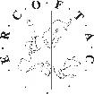

Scientific societies
Sociedad Española de Métodos Numéricos en Ingeniería
CIMNE holds the General Secretariat of the Spanish Association for Numerical Methods in Engineering.
International Association For Computational Mechanics
CIMNE holds the General Secretariat of the International Association for Computational Mechanics.
European Community on Computational Methods in Applied Sciences
CIMNE holds the Secretariat of the European Community on Computational Methods in Applied Sciences.
European Research Community On Flow, Turbulence And Combustion
CIMNE is a Pilot Centre for the European Research Community in Flow, Turbulence and Combustion. ERCOFTAC Spanish Pilot Centre.
International Association of CIMNE Classrooms
The International Association of CIMNE Classrooms is a non-governmental civil non-profit organization which aims to promote the advancement of numerical methods in a common academic space.

Slide 19
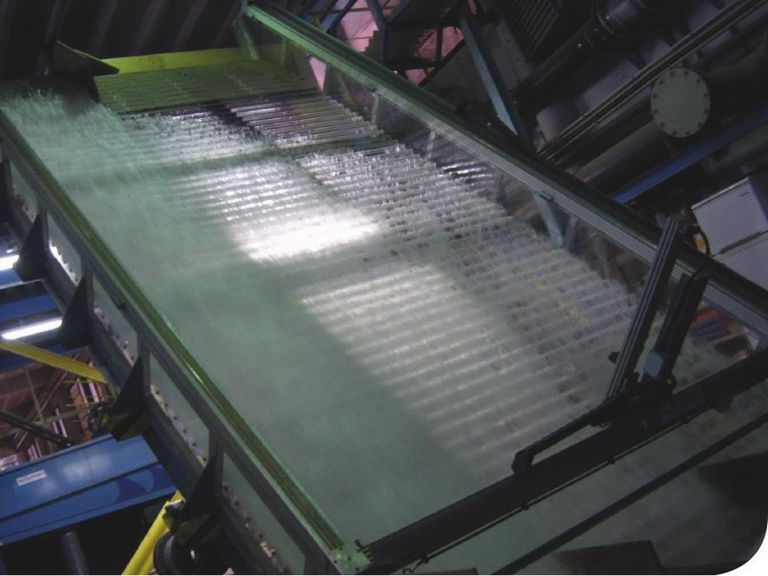
NEW BROAD RESEARCH AREAS AND ALLIANCES
FLUMEN Institute
for River Dynamics and Hydrologic Engineering
A partnership between CIMNE and UPC · BarcelonaTech,
since 2012.
The objectives of FLUMEN are the promotion of research and technology transfer activities in the field of river dynamics and hydrologic engineering.
The Flumen Institute is directed by Prof. Josep Dolz.
MEMBERS

Slide 20
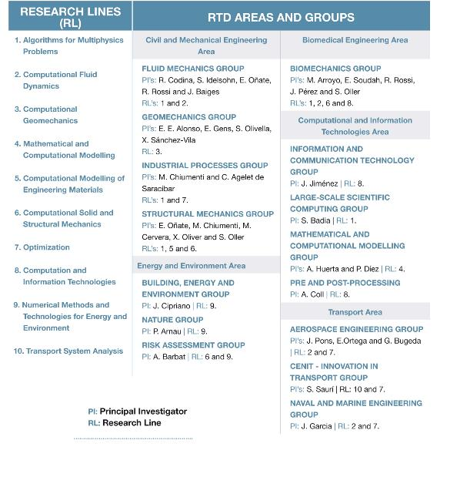
RESEARCH LINES, RTD AREAS AND GROUPS

Slide 21
Research lines

Slide 22
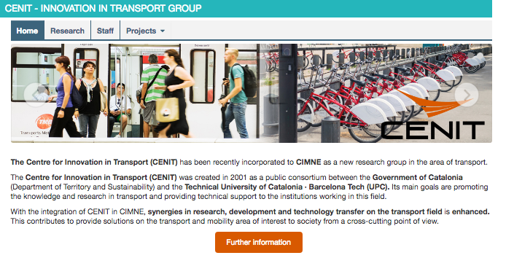
CENIT
NEW RESEARCH GROUP ON INNOVATION IN TRANSPORT
Since May 2017

Slide 23
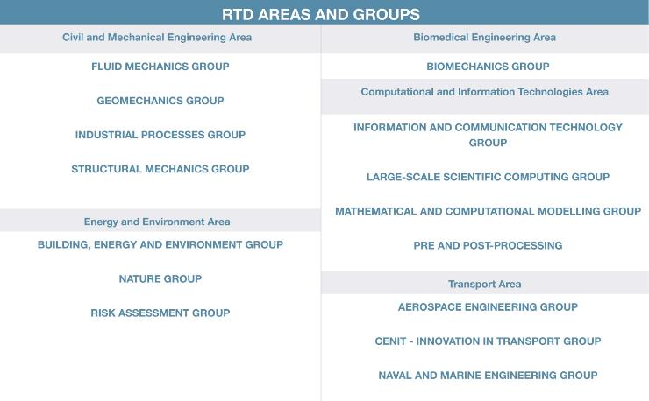
Research areas and groups

Slide 24
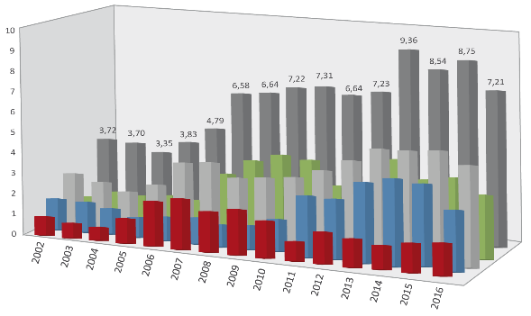
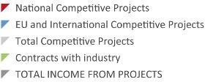
RTD projects
INCOME FROM RTD PROJECTS (2002-2016)
Information at 21/03/2017
More than 2,000 RTD projects in cooperation with some 600 companies since 1987
–In M€–
ON-GOING RTD PROJECTS:
National Projects: 40
International Projects: 46
Contracts with Industry: 98
TOTAL: 184
PAST PROJECTS
ON-GOING PROJECTS
MORE
GRAPHICS

Slide 25
RTD projects
RTD PROJECTS FUNDED BY PUBLIC ORGANIZATIONS
RTD PROJECTS FUNDED BY INDUSTRY

Slide 26
Relevant RTD projects
ADVANCED GRANTS
SAFECON: New Computational Methods for Predicting the security of constructions to Water
Hazards accounting for fluid-soil-structure interactions. Prof. Eugenio Oñate
COMP-DES-MAT: Advanced tools for computational design of engineering materials.
Prof. Javier Oliver
REALTIME: Real Time Computational Mechanics Techniques for Multi-Fluid Problems.
Prof. Sergio Idelsohn
STARTING GRANTS
COMFUS: Computational Methods for Fusion Technology. Prof. Santiago Badia
PROOFS OF CONCEPT
CATALOG: Computational catalog of multiscale materials: a plug-in library for industrial finite element codes. Prof. Javier Oliver
FEXFEM: On a free open source extreme scale finite element software. Prof. Santiago Badia
FORECAST: Assessment and initial steps for the exploitation of a fast simulation software for casting manufacturing operations. Prof. Sergio Idelsohn
FLOODSAFE: Asessment and initial steps for the exploitation of a simulation software for the study and mitigation of the effect of floods on constructions and landscape. Prof. Eugenio Oñate
ICEBREAKER: Industrial applicability and potential for commercialization of the computational technology developed in SAFECON. Prof. Eugenio Oñate
NUWASIM: On a Nuclear Waste Deep Repository Simulator. Prof. Santiago Badia
GRANTS

Slide 27
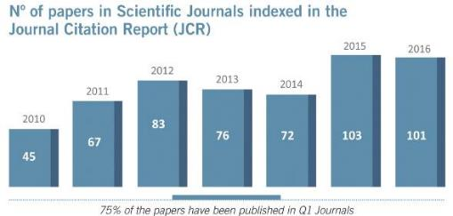
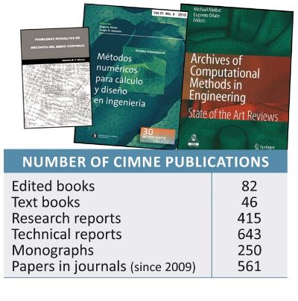
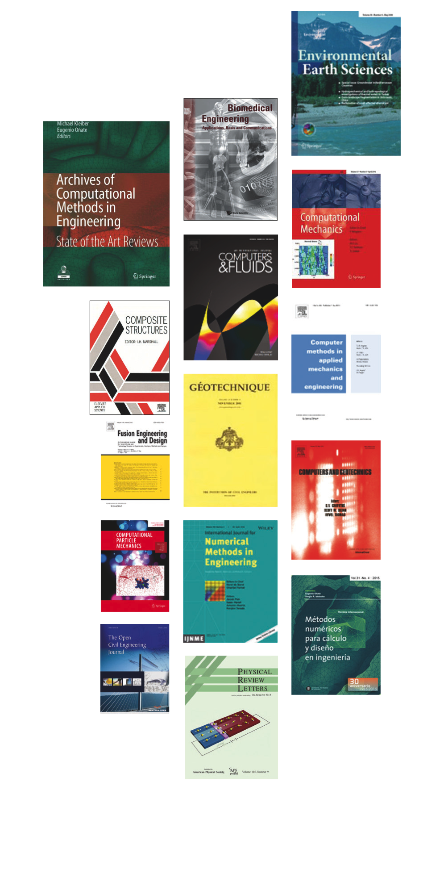
PUBLICATIONS
More than 1,400 publications since 1987

Slide 28
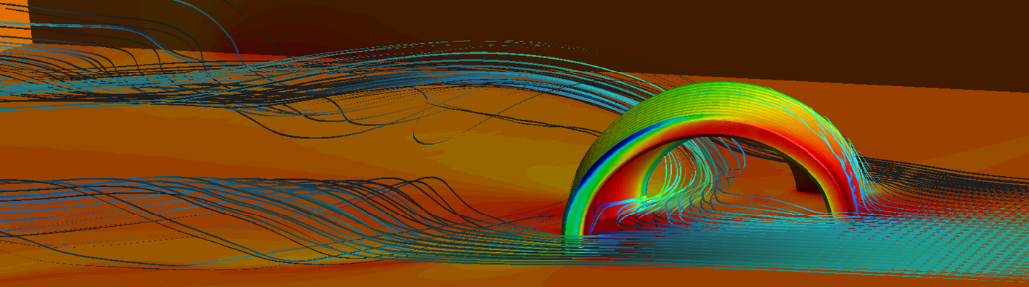
TECHNOLOGY TRANSFER
A vocation for Technology Transfer since 1987.
Creation of CIMNE Tecnología, SA. (2011), a company 100% owned by CIMNE, in charge of the technology transfer of CIMNE outputs.
16 spin-off companies.
PRODUCTS
SPIN-OFF
COMPANIES
CIMNE
TECNOLOGÍA

Slide 29
















16 SPIN-OFF COMPANIES
Created in 2001
Created in 2002
Created in 2006
SOLUCIONES INTEGRALES DE FORMACIÓN Y GESTIÓN STRUCTURALIA, SA
COMPASS INGENIERÍA Y SISTEMAS, SA
INGENIA IAE
CIMNE TECNOLOGÍA
BEFORE 2011
It promotes the participation of its members in projects of aeronautics and the space field.
It is formed by several companies and CIMNE.
Applications of numerical methods in civil, naval and maritime engineering.
CIMNE owns 24% of COMPASS.
Created in 2011, the company is owned by CIMNE aiming to industrialize and market the outputs of CIMNE research.
E-Training and consulting activities in civil engineering. It was sold in 2011 to The Washington Post Group.
BIOMECHANICS DEVELOPMENTS, SL
BEEDATA ANALYTICS, SL
BUILDAIR INGENERÍA Y
ARQUITECTURA, SA
COMPUTATIONAL AND INFORMATION TECHNOLOGIES, SA
FRESH WATER NATURE, SL
Software solutions and services in biomedical field.
50% owned by CIMNE Tecnología.
Mass analytical data treatment to users and business intelligence.
56,82% owned by CIMNE Tecnología.
Inflatables structures for engineering and architecture applications.
5% owned by CIMNE Tecnología.
Computational methods and information technology systems in engineering.
100% owned by CIMNE Tecnología.
Solutions for obtaining fresh water from desalination and destillation of waste water.
100% owned by CIMNE Tecnología.
HEALTHAPP, SL
RSM GASSÓ CIMNE ENERGY, SL
INLOC ROBOTICS, SL
LYNCOS TECHNOLOGIES, SL
PORTABLE MULTIMEDIA SOLUTIONS, SL
Software to treat eating disorders. It improves the links therapist / patient.
15% owned by CIMNE Tecnología.
Advanced engineering energy services. 50% owned by Servicios Energéticos Avanzados, which is 100% owned by CIMNE Tecnología.
Positioning and navigation solutions for mobile robots in buried environments.
5% owned by CIMNE Tecnología since 2015.
Software and systems for the Internet of Things.
15% owned by CIMNE Tecnología.
Mobile pavilions with multimedia technology for leisure, sport and events.
20% owned by CIMNE Tecnología.
PNEUMATIC STRUCTURES TECHNOLOGIES, SL
TECNOLOGÍAS AVANZADAS PARA EL OCIO, SL
QUANTECH ATZ
SCIPEDIA, SL
Pneumatic structures for a wide range of engineering problems.
10% owned by CIMNE Tecnología.
Software for production processes. CIMNE Tecnología joined the company in 2015, with a share of 3,5%.
Free publishing and open access for scientific publications.
16,67% owned by CIMNE Tecnología.
Information systems for leisure sectors (tourism, music…).
100% owned by CIMNE Tecnología.

Slide 30

INTERNATIONAL events
Organizer of 200 scientific events on
Computational Engineering since 1987.
CONGRESS
BUREAU

Slide 31
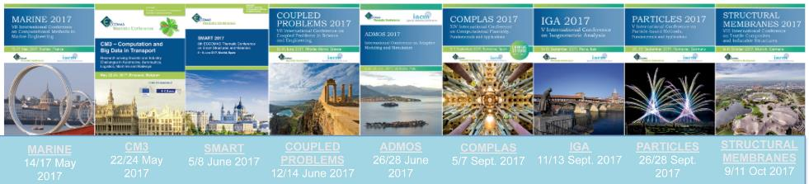
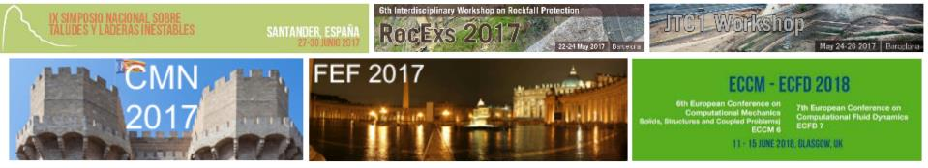
INTERNATIONAL events
ORGANIZED BY CIMNE CONGRESS BUREAU
2017/2018
ECCOMAS CONFERENCES 2017
OTHER INTERNATIONAL CONFERENCES AND WORKSHOPS

Slide 32


SEMINARS and COFFEE TALKS
FURTHER INFO
SOME 20 SEMINARS AND
30 CIMNE COFFE TALKS HELD ANNUALLY

Slide 33




POST GRADUATE STUDIES
FURTHER INFO
CIMNE manages Masters courses and PhD programmes on Computational Engineering
in cooperation with international universities.
MASTER DEGREES
PhD DEGREES
Awarded by Universitat Politècnica de Catalunya (UPC)
Awarded by Universitat Politècnica de Catalunya (UPC)

Slide 34
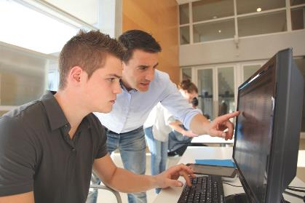
PHDS AND MSC STUDENTS IN 1987-2017
SOME 120 PHDs COMPLETED UNDER SUPERVISION OR CO-SUPERVISION OF CIMNE RESEARCHERS
SOME 650 MSC STUDENTS TRAINED

